Slide 1
Session – 8
Reverse Engineering

Slide 2
Recap for session 7
Software Re-Engineering
  The need of software Re-engineering
Re-engineering Cost Factor
Software Re-Engineering Activities
Re-engineering Process
Reuse
Advantage and disadvantage

Slide 3
Agenda for session 8
Reverse Engineering – Definition
Reverse Engineering Goals:
Steps of Software Reverse Engineering
Reverse Engineering Tools:
Difference between Forward Engineering and Reverse Engineering:
Benefits of Reverse Engineering
Where Reverse Engineering is used
Business Process Reengineering (BBR)
These slides are designed to accompany Software Engineering: A Practitioner’s Approach, 7/e (McGraw-Hill 2009). Slides copyright 2009 by Roger Pressman.

Slide 4
Reverse Engineering - Definition
It is a process to achieve system specification by thoroughly analyzing, understanding the existing system. This process can be seen as reverse SDLC model,
These slides are designed to accompany Software Engineering: A Practitioner’s Approach, 7/e (McGraw-Hill 2009). Slides copyright 2009 by Roger Pressman.

Slide 5
Reverse Engineering
Software Reverse Engineering is a process of recovering the design, requirement specifications and functions of a product from an analysis of its code. It builds a program database and generates information from this.
The purpose of reverse engineering is to facilitate the maintenance work by improving the understandability of a system and to produce the necessary documents for a legacy system.
These slides are designed to accompany Software Engineering: A Practitioner’s Approach, 7/e (McGraw-Hill 2009). Slides copyright 2009 by Roger Pressman.

Slide 6
Reverse Engineering Goals:
Cope with Complexity.
Recover lost information.
Detect side effects.
Synthesise higher abstraction.
Facilitate Reuse.
These slides are designed to accompany Software Engineering: A Practitioner’s Approach, 7/e (McGraw-Hill 2009). Slides copyright 2009 by Roger Pressman.

Slide 7
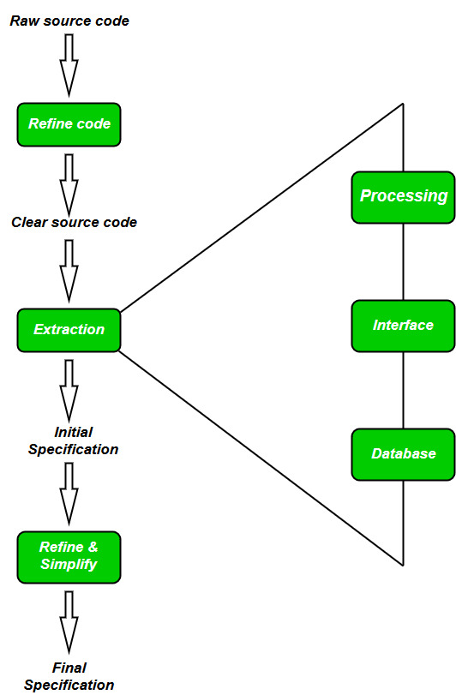
Steps of Software Reverse Engineering
These slides are designed to accompany Software Engineering: A Practitioner’s Approach, 7/e (McGraw-Hill 2009). Slides copyright 2009 by Roger Pressman.

Slide 8
Steps of Software Reverse Engineering (Cont..):
Collection Information:
This step focuses on collecting all possible information (i.e., source design documents etc.) about the software.
Examining the information:
The information collected in step-1 as studied so as to get familiar with the system.
Extracting the structure:
This step concerns with identification of program structure in the form of structure chart where each node corresponds to some routine.
These slides are designed to accompany Software Engineering: A Practitioner’s Approach, 7/e (McGraw-Hill 2009). Slides copyright 2009 by Roger Pressman.

Slide 9
Steps of Software Reverse Engineering: (Cont..)
Recording the functionality:
During this step processing details of each module of the structure, charts are recorded using structured language like decision table, etc.
5. Recording data flow:
From the information extracted in step-3 and step-4, set of data flow diagrams are derived to show the flow of data among the processes.
6 Recording control flow:
High level control structure of the software is recorded.
These slides are designed to accompany Software Engineering: A Practitioner’s Approach, 7/e (McGraw-Hill 2009). Slides copyright 2009 by Roger Pressman.

Slide 10
Steps of Software Reverse Engineering: (Cont…)
Review extracted design:
Design document extracted is reviewed several times to ensure consistency and correctness. It also ensures that the design represents the program.
8 Generate documentation:
Finally, in this step, the complete documentation including SRS, design document, history, overview, etc. are recorded for future use.
These slides are designed to accompany Software Engineering: A Practitioner’s Approach, 7/e (McGraw-Hill 2009). Slides copyright 2009 by Roger Pressman.

Slide 11
Reverse Engineering Tools:
Reverse engineering if done manually would consume lot of time and human labour and hence must be supported by automated tools. Some of tools are given below:
CIAO and CIA: A graphical navigator for software and web repositories along with a collection of Reverse Engineering tools.
Rigi: A visual software understanding tool.
Bunch: A software clustering/modularization tool.
GEN++: An application generator to support development of analysis tools for the C++ language.
PBS: Software Bookshelf tools for extracting and visualizing the architecture of programs.
These slides are designed to accompany Software Engineering: A Practitioner’s Approach, 7/e (McGraw-Hill 2009). Slides copyright 2009 by Roger Pressman.

Slide 12
Difference between Forward Engineering and Reverse Engineering:
S.NO | Forward Engineering | Reverse Engineering
1. | In forward engineering, the application are developed with the given requirements. | In reverse engineering or backward engineering, the information are collected from the given application.
2. | Forward Engineering is a high proficiency skill. | Reverse Engineering or backward engineering is a low proficiency skill.
3. | Forward Engineering takes more time to develop an application. | While Reverse Engineering or backward engineering takes less time to develop an application.
4. | The nature of forward engineering is Prescriptive. | The nature of reverse engineering or backward engineering is Adaptive.
5. | In forward engineering, production is started with given requirements. | In reverse engineering, production is started by taking the products existing products.
6. | The example of forward engineering is the construction of electronic kit, construction of DC MOTOR , etc. | An example of backward engineering is research on Instruments etc.

Slide 13
Benefits of Reverse Engineering
Exploring existing designs and maneuvers. ...
Reconstructing a product that is outdated. ...
Discovering any product vulnerabilities. ...
Bringing less expensive & more efficient products to the market. ...
Creating a reliable CAD model for future reference. ...
Inspiring creative minds with old ideas
These slides are designed to accompany Software Engineering: A Practitioner’s Approach, 7/e (McGraw-Hill 2009). Slides copyright 2009 by Roger Pressman.

Slide 14
Where is reverse engineering used?
Automobile industry
The automobile industry uses backward engineering for:
studying and analysing competitors
digitalising parts of older vehicle models
understanding problems and issues with existing automobiles
developing replacement parts
These slides are designed to accompany Software Engineering: A Practitioner’s Approach, 7/e (McGraw-Hill 2009). Slides copyright 2009 by Roger Pressman.

Slide 15
Where is reverse engineering used? (cont…)
Aerospace industry
The aerospace industry uses this technique for:
developing maintenance parts of an aircraft
adding, enhancing and fixing aircraft components
conducting aerodynamic analysis
manufacturing of tools
These slides are designed to accompany Software Engineering: A Practitioner’s Approach, 7/e (McGraw-Hill 2009). Slides copyright 2009 by Roger Pressman.

Slide 16
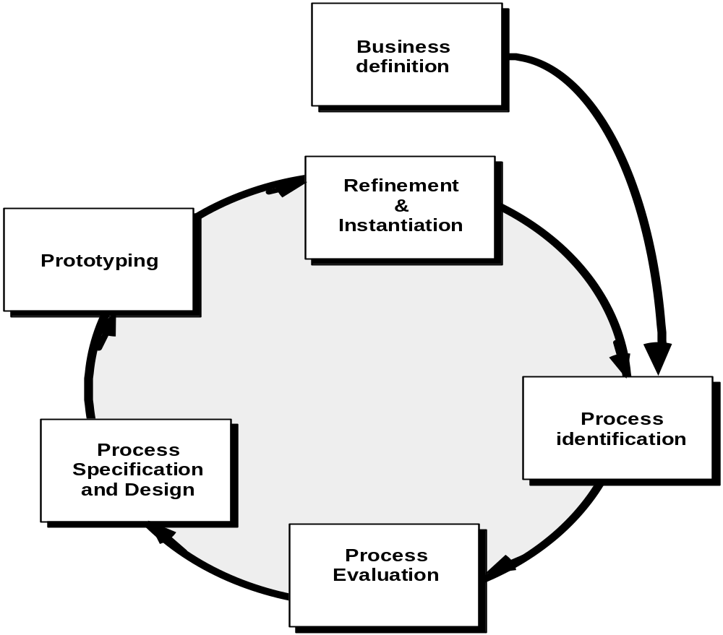
Business Process Reengineering (BBR)

Slide 17
Business Process Reengineering
Business definition. Business goals are identified within the context of four key drivers: cost reduction, time reduction, quality improvement, and personnel development and empowerment.
Process identification. Processes that are critical to achieving the goals defined in the business definition are identified.
Process evaluation. The existing process is thoroughly analyzed and measured.
Process specification and design. Based on information obtained during the first three BPR activities, use-cases are prepared for each process that is to be redesigned.
Prototyping. A redesigned business process must be prototyped before it is fully integrated into the business.
Refinement and instantiation. Based on feedback from the prototype, the business process is refined and then instantiated within a business system.

Slide 18
BPR Principles
Organize around outcomes, not tasks.
Have those who use the output of the process perform the process.
Incorporate information processing work into the real work that produces the raw information.
Treat geographically dispersed resources as though they were centralized.
Link parallel activities instead of integrated their results. When different
Put the decision point where the work is performed, and build control into the process.
Capture data once, at its source.

Slide 19
Questions:
Need of Reengineering.
What are BPR Principles.
Purpose of Inventory Analysis.
How Forward Engineering work.
Advantage of Code Restructuring.

